Slide 1

Predict Age, Gender and Ethnicity
Group 2
Debsankar Mukhopadhyay
Vasim Shaikh
William Yerkes
Prabhanjan Trivedi
CS5542 – Big Data Analytics and Application - Project Presentation

Slide 2

Content
Introduction
Background and Related Works
Architecture and Methodology
Data, Code Snippet, and Results
Conclusion
Q & A

Slide 3
Introduction
Provide the ability for companies to utilize their CCTV to capture images of their clients so as to be able to determine the demographics of their clientele so as to customize their marketing strategies to be able to be able to maximize the capital investment in targeted advertisement.
Utilize Artificial Neural Networks, (Convolutional Neural Network for this model) to analyze the images and determine the age, gender and ethnicity of the clientele
Create a single model that can determine all Three of the categories
Ability to be able to determine the mood of person based on image (Happy, Sad, etc.)

Slide 4
Background
The structure of a CNN architecture is divided into multiple learning stages composed of convolutional layers, non-linear processing units, and subsampling layers
A typical CNN architecture is made up of alternate layers of convolution and pooling followed by one or more fully connected layers at the end. The CNN performance can be optimized by introducing mapping functions, batch normalization and dropout components. The pattern learning activities are aided by activation functions.

Slide 5
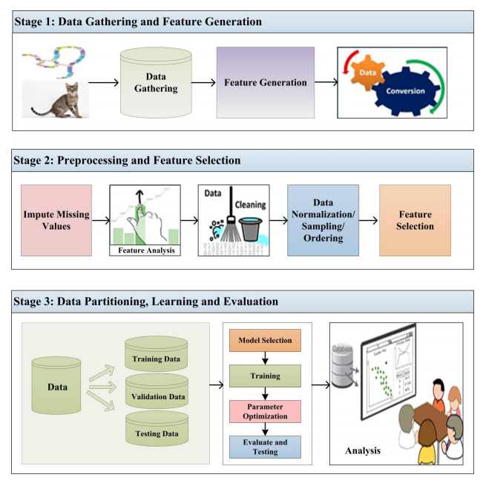
Background
Diagram of a Machine Learning (ML) system

Slide 6
Related Works
Age, Gender, and Ethnicity Determination
“Age estimation from faces using deep learning: A comparative analysis.” by : Alice Othmani, A. R. Talebb, H. Abdelkawya and A. Hadidc
“Joint gender, ethnicity and age estimation from 3D faces: An experimental illustration of their correlations.” by: B. Xia, B. B. Amor and M. Daoudi
“A hybrid deep learning CNN–ELM for age and gender classification.” by: M. Duan, K. Li, C. Yang and K. Li
“Effective training of convolutional neural networks for face-based gender and age predictio.” by: G. Antipov, M. Baccouche, S.-A. Berrani and J.-L. Dugelay
Mood Detection
“Facial expression recognition using optimized active regions” by: A. Sun, Y. Li, Y.-M. Huang, Q. Li and G. Lu

Slide 7
Architecture and Methodology
Convolutional Neural Network (CNN) used to create the Model.
CNNs are used for image classification and recognition because of its high accuracy
Used multi-output CNN which for the ability to have a single model
CNN is widely used because of their generalization ability on unseen data and ability to handle over-fitting unlike others.
Research what others had done to solve the same problem and study their models.
Create and Experiment with various Models to determine what path to follow.
One model with 3 branches, one for age, ethnicity, and gender each.
Merge parameters into single parameter, creating single branch model.
We settled on One model with 3 branches.

Slide 8
Architecture and Methodology
Input Data
(Age, Gender, Ethnicity, Image)
Data Preprocessing
Unified Model
Model Training
Model Evaluation
Validation or Prediction

Slide 9
Unified Model
Input Layer
CNN Layer 1
(Activation,BatchNormalization,
MaxPooling2D, Dropout, Conv2d)
CNN Layer 2
(Activation,BatchNormalization,
MaxPooling2D, Dropout, Conv2d)
CNN Layer 3
(Activation,BatchNormalization,
MaxPooling2D, Dropout, Conv2d)
Ethnicity
Flatten
Dense
Activation
BatchNormalization
Dropout
Dense
Activation(softmax)
Gender
Flatten
Dense
Activation
BatchNormalization
Dropout
Dense
Activation(sigmoid)
Age
Flatten
Dense
Activation
BatchNormalization
Dropout
Dense
Activation(linear)

Slide 10
Data
23705 Facial Images
Image Size is 48 x 48 pixels
Classifications
Data is classified bases on three parameters:
Age, Ethnicity and Gender
Age has a range of 0 to 116
Ethnicity is broken down into 5 categories
Gender is classified as Male or Female
Data Distribution was not uniform

Slide 11
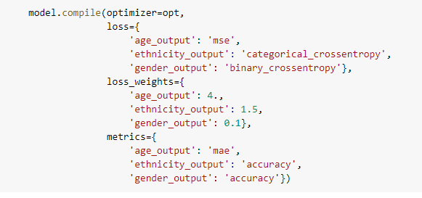
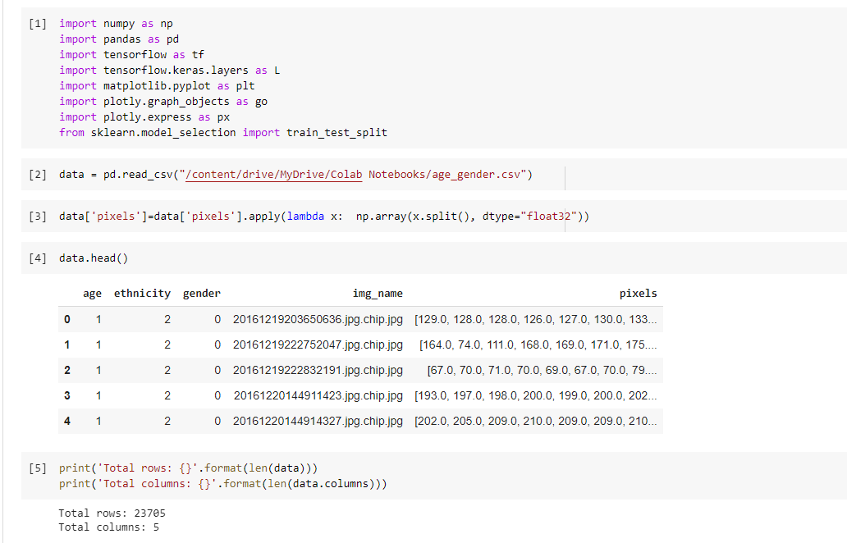
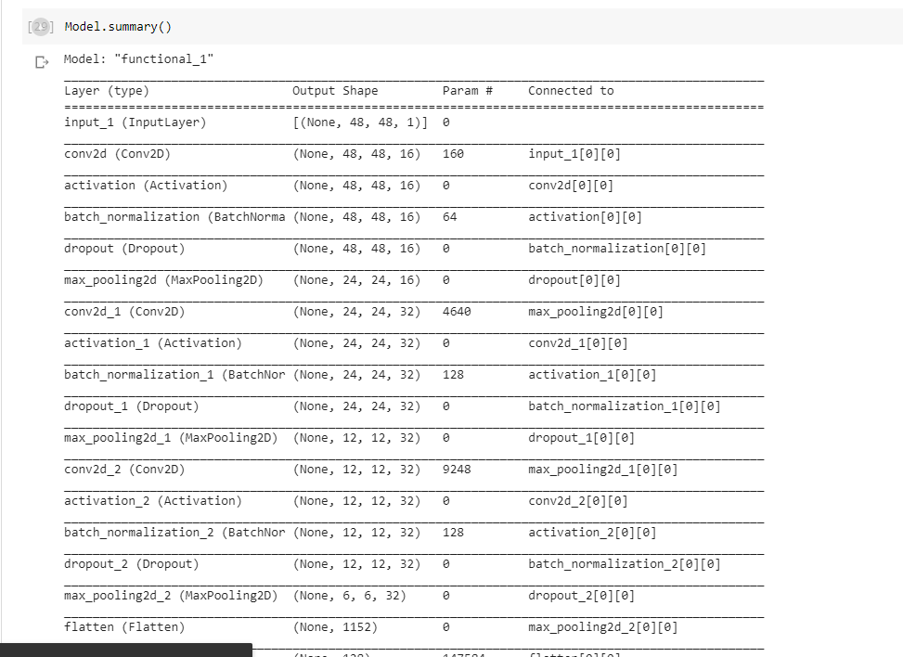
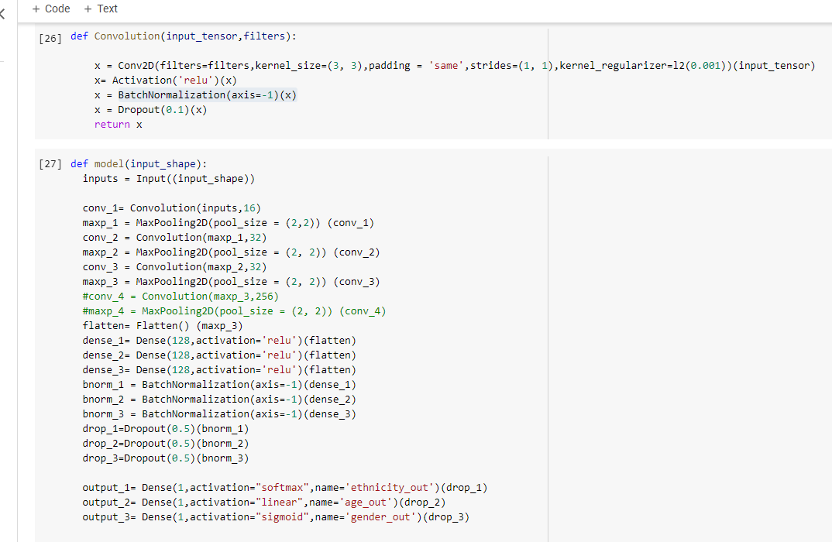
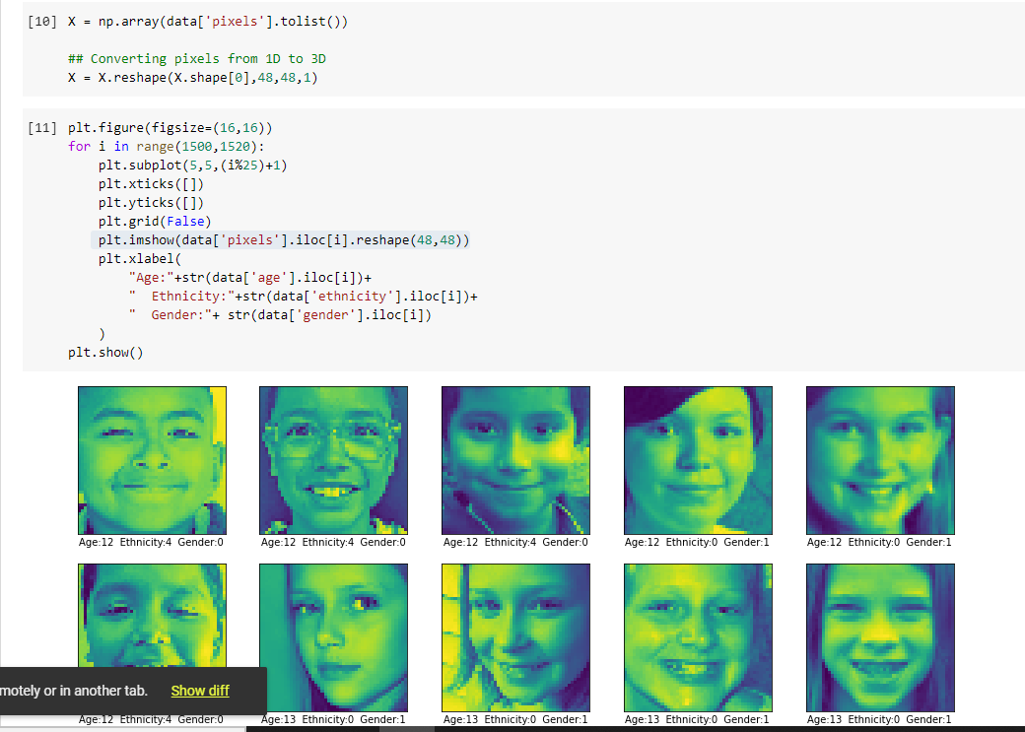
Code Snippets

Slide 12
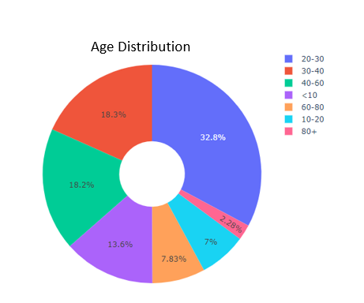
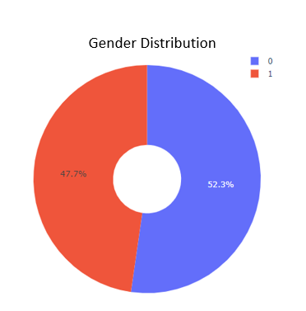
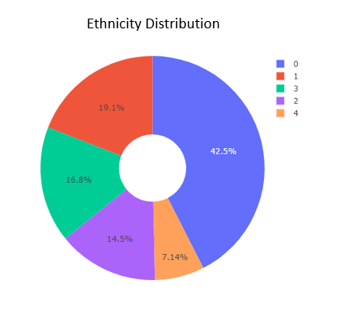
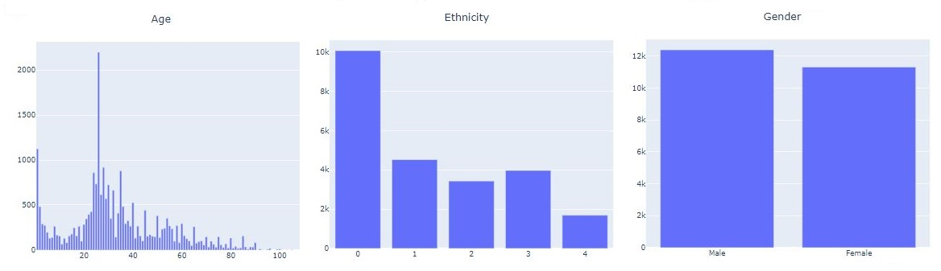
Data Distribution

Slide 13
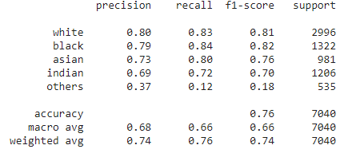
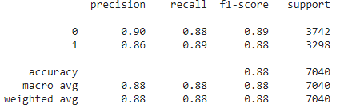

Results
Race Accuracy of 76%
Category 0 ………………………..82%
Category 1 …………………….....81%
Category 2 …………………….....78%
Category 3 ………………………..69%
Category 4 …………………….....11%
Gender Accuracy of 89%
Male ………………………………...89 %
Female ……………………...……..88 %
Age Accuracy of 75%
Mean Absolute Error ………..7.3

Slide 14
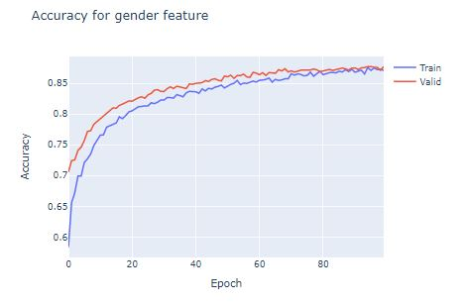
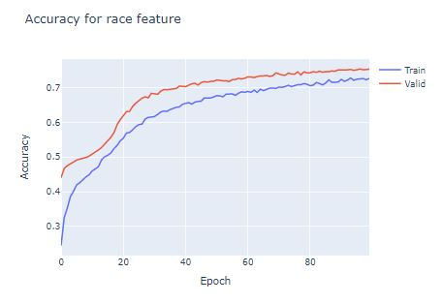
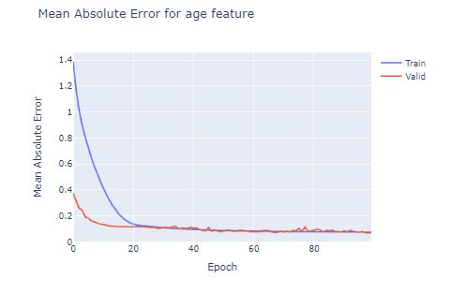
Results

Slide 15
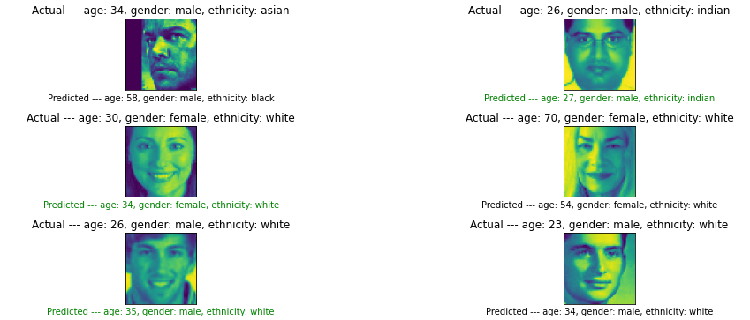
Discussions
Random image sample to test model.

Slide 16
Challenges
CPU / GPU posed a challenge when training the model, because of limited access to the GPU and resource limitations. This caused the training to take longer then desired.
Limited number of published article with provided access to sample code to help replicate ideas and solutions described in the articles.
Limited experience with working CNN architecture and machine learning. Offered excellent opportunity to learn what to do and some thing not to do.
Working remotely, lack of face to face interaction during the middle of a pandemic. While also working full time.

Slide 17
Conclusions and Future Outlook
Successful implementation of a multi-output multi-layered CNN to identify age, gender and ethnicity.
Were able to get comparable results to solutions which were implemented with separate models for predicting each of the categories, with a single unified model.
Improved performance Single Model vs Three Models
Future area for enhancements would be improvement of determining the mood of person based on image (Happy, Sad, etc.)

Slide 18
Q & A

Slide 19
THANK YOU

